Slide 1
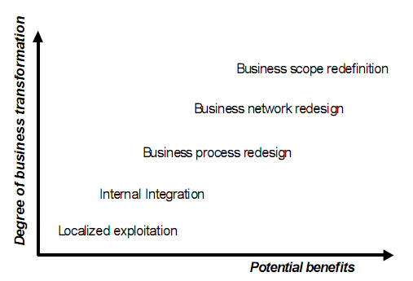
Beyond Enterprise Architecture

Slide 2
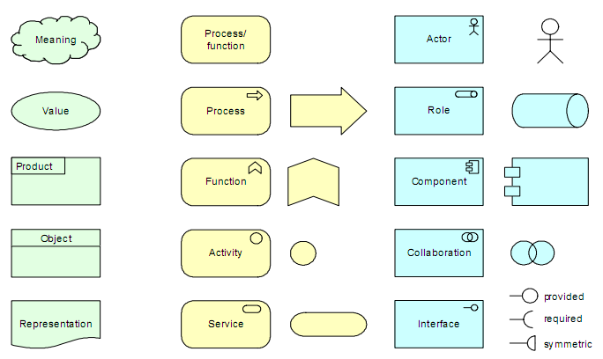
Appendix B – Graphical Notation

Slide 3
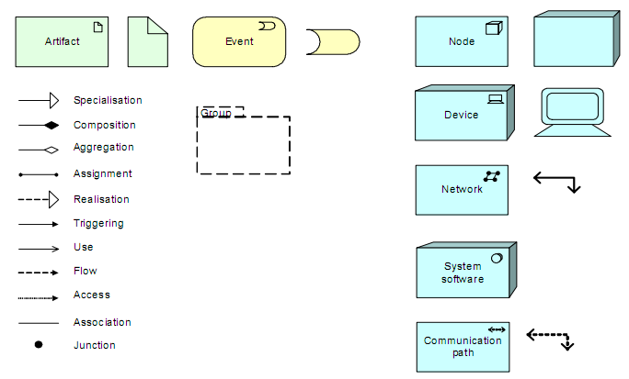
Appendix B – Graphical Notation

